Slide 1
Linear Algebra
IST 718 – Advanced Information Analytics
Adjunct Professor Willard Williamson
linkedin.com/in/ncc-1701-d

Slide 2
Attendance
Please fill out the class attendance sheet
Place a “1” (which stands for present) in the row next to your name for today’s date in the attendance sheet.
Attendance sheet is here: https://docs.google.com/spreadsheets/d/1G5tiqXQn9mwyubWdINtPI_QONXH1_2U8oYikksgWlss/edit?usp=sharing

Slide 3
Objectives
Will take an “application oriented” approach to linear algebra in this class as opposed to a theoretical approach
Not a comprehensive survey of linear algebra
Focused on linear algebra subset most relevant to machine learning

Slide 4
Linear Algebra Review Material
Course Text Book: Deep Learning by Ian Goodfellow, Yoshua Bengio & Aaron Couville, MIT Press, 2017:
http://www.deeplearningbook.org/contents/linear_algebra.html
https://www.deeplearningbook.org/slides/02_linear_algebra.pdf
A good review from Upenn:
https://www.ling.upenn.edu/courses/cogs501/LinearAlgebraReview.html

Slide 5
Linear Algebra Deep Dive
Introduction to Linear Algebra, Gilbert Strang:
http://math.mit.edu/~gs/linearalgebra/
Dr. Gilbert Strang is a world famous MIT math professor
Note that Dr. Strang has free linear algebra courses on YouTube.

Slide 6
Introduction
Quote by Gilbert Strang: Linear Algebra has become as basic and applicable as calculus, and fortunately it is easier.
Linear algebra appears in virtually every branch of applied mathematics, physics, mathematical economics, etc.
Linear algebra is very important to
Big data analytics
Machine learning – especially deep learning
Inferential and exploratory statistics
Many other fields in science

Slide 7
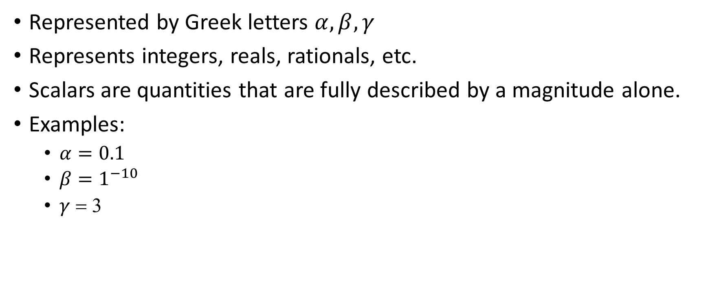
Scalars
Represented by Greek letters $α,β,γ$
Represents integers, reals, rationals, etc.
Scalars are quantities that are fully described by a magnitude alone.
Examples:
$α=0.1$
$β=1^{−10}$
$γ$ = 3
Notes:
https://www.physicsclassroom.com/class/1DKin/Lesson-1/Scalars-and-Vectors

Slide 8

Vectors
Represented by lower case letters
A vector is a 1-D array of scalars:
$a=\left[\begin{aligned}a_{1} \\ a_{2} \\ a_{3} \\ {\begin{aligned}… \\ a\end{aligned}}_{1}\end{aligned}\right]$
A vector is also a single column matrix
Notes:
https://www.physicsclassroom.com/class/1DKin/Lesson-1/Scalars-and-Vectors

Slide 9
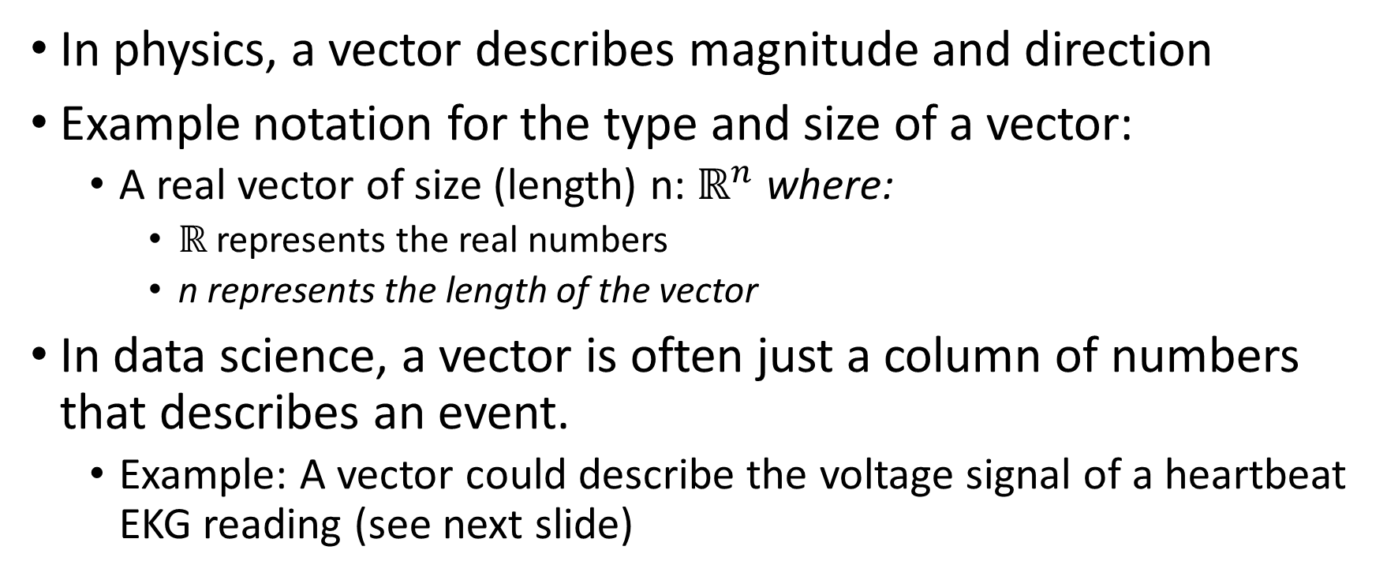
Vectors Continued
In physics, a vector describes magnitude and direction
Example notation for the type and size of a vector:
A real vector of size (length) n: $ℝ^{n}$ where:
$ℝ$ represents the real numbers
n represents the length of the vector
In data science, a vector is often just a column of numbers that describes an event.
Example: A vector could describe the voltage signal of a heartbeat EKG reading (see next slide)

Slide 10
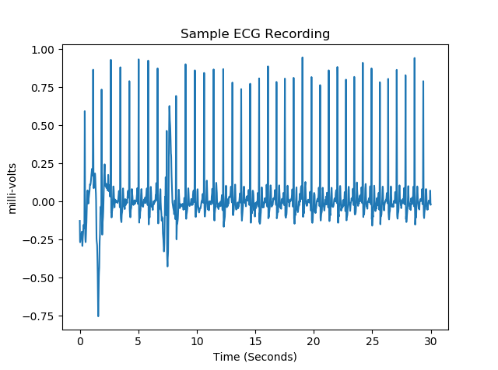
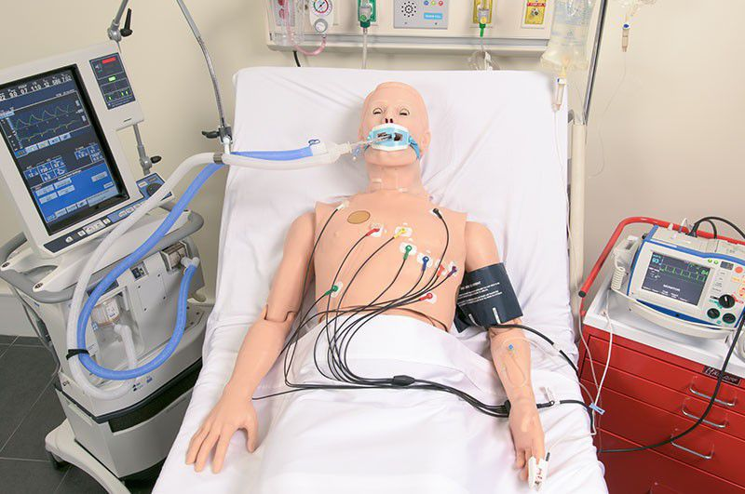
EKG Data Vector

Slide 11
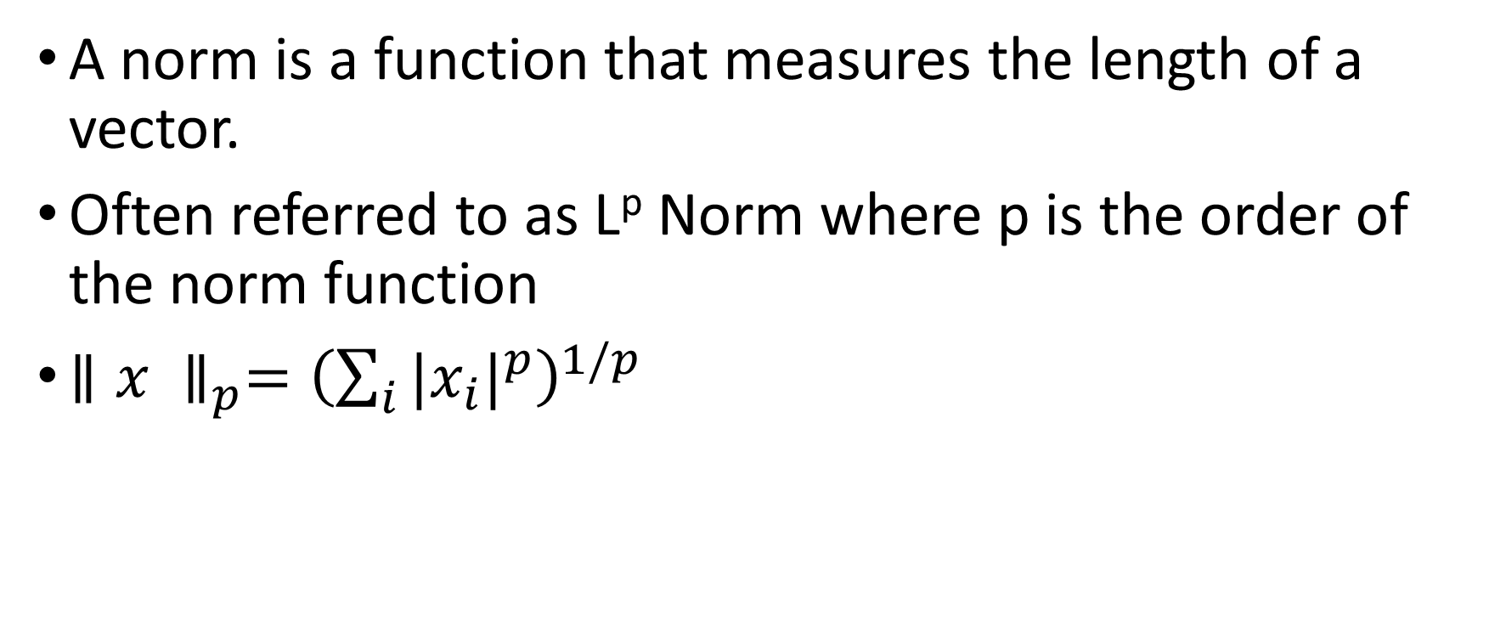
Norms
A norm is a function that measures the length of a vector.
Often referred to as L^{p} Norm where p is the order of the norm function
${∥x ∥}_{p}={\left(\sum_{i}{{|x_{i}|}^{p}}\right)}^{1/p}$
Notes:
https://machinelearningmastery.com/vector-norms-machine-learning/

Slide 12
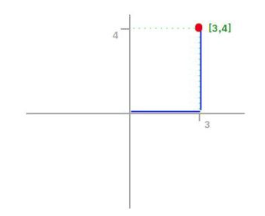
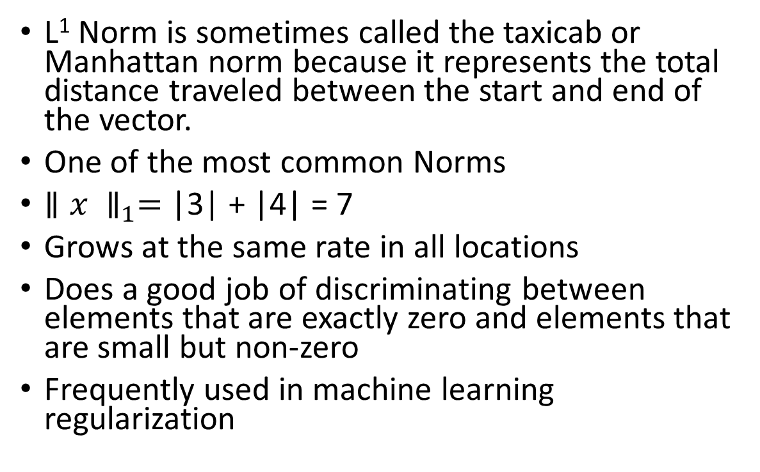
L1 Norm
L¹ Norm is sometimes called the taxicab or Manhattan norm because it represents the total distance traveled between the start and end of the vector.
One of the most common Norms
${∥x ∥}_{1}=$ |3| + |4| = 7
Grows at the same rate in all locations
Does a good job of discriminating between elements that are exactly zero and elements that are small but non-zero
Frequently used in machine learning regularization

Slide 13
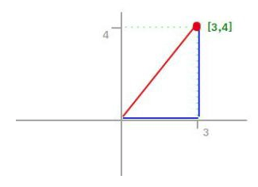
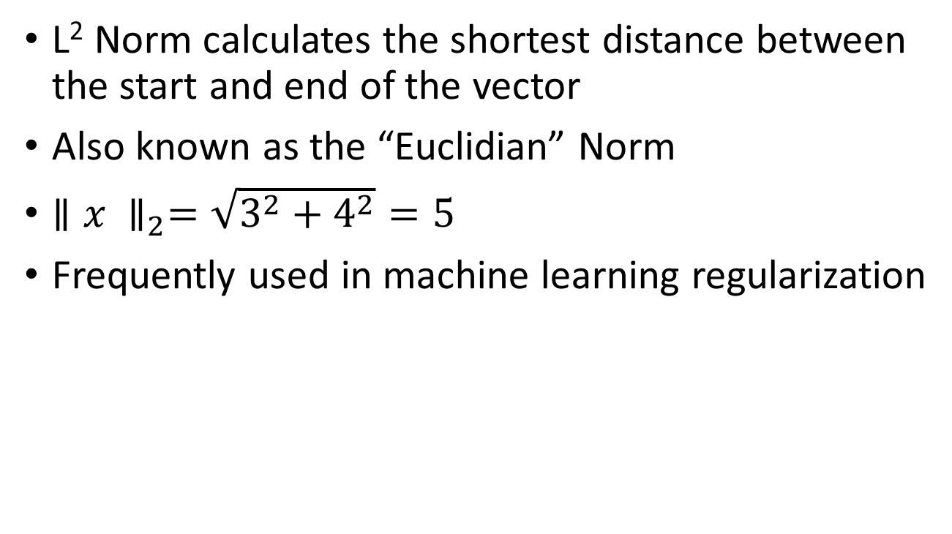
L2 Norm
L² Norm calculates the shortest distance between the start and end of the vector
Also known as the “Euclidian” Norm
${∥x ∥}_{2}=\sqrt{3^{2}+4^{2}}=5$
Frequently used in machine learning regularization
5

Slide 14

Vector Dot Product
The dot product of 2 vectors yields a scalar
Given:
$a=\left[a_{1} a_{2} a_{3}\right]$
$b=\left[b_{1} b_{2} b_{3}\right]$
$a∗b=\sum_{i}{a_{i}b_{i}}$
$\left[a_{1} a_{2} a_{3}\right]∗\left[b_{1} b_{2} b_{3}\right]= \left[a_{1}b_{1}+a_{2}b_{2}+a_{3}b_{3}\right]$

Slide 15
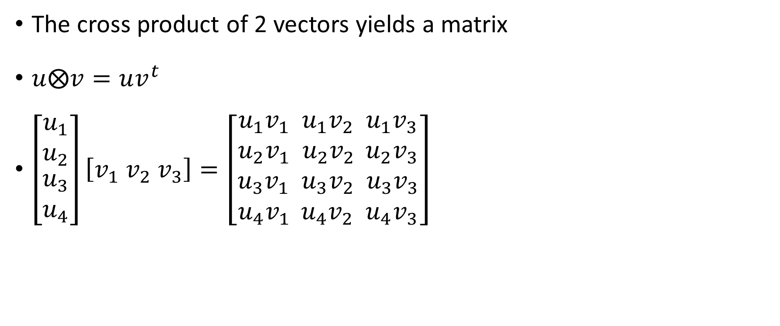
Vector Cross Product
The cross product of 2 vectors yields a matrix
$u⨂v=uv^{t}$
$\left[\begin{matrix}u_{1} \\ u_{2} \\ \begin{aligned}u_{3} \\ u_{4}\end{aligned}\end{matrix}\right]\left[v_{1}{ v}_{2}{ v}_{3}\right]=\left[\begin{aligned}u_{1}v_{1} u_{1}v_{2} u_{1}v_{3} \\ u_{2}v_{1} u_{2}v_{2 } u_{2}v_{3} \\ u_{3}v_{1} u_{3}v_{2} u_{3}v_{3} \\ u_{4}v_{1 } u_{4}v_{2} u_{4}v_{3}\end{aligned}\right]$

Slide 16
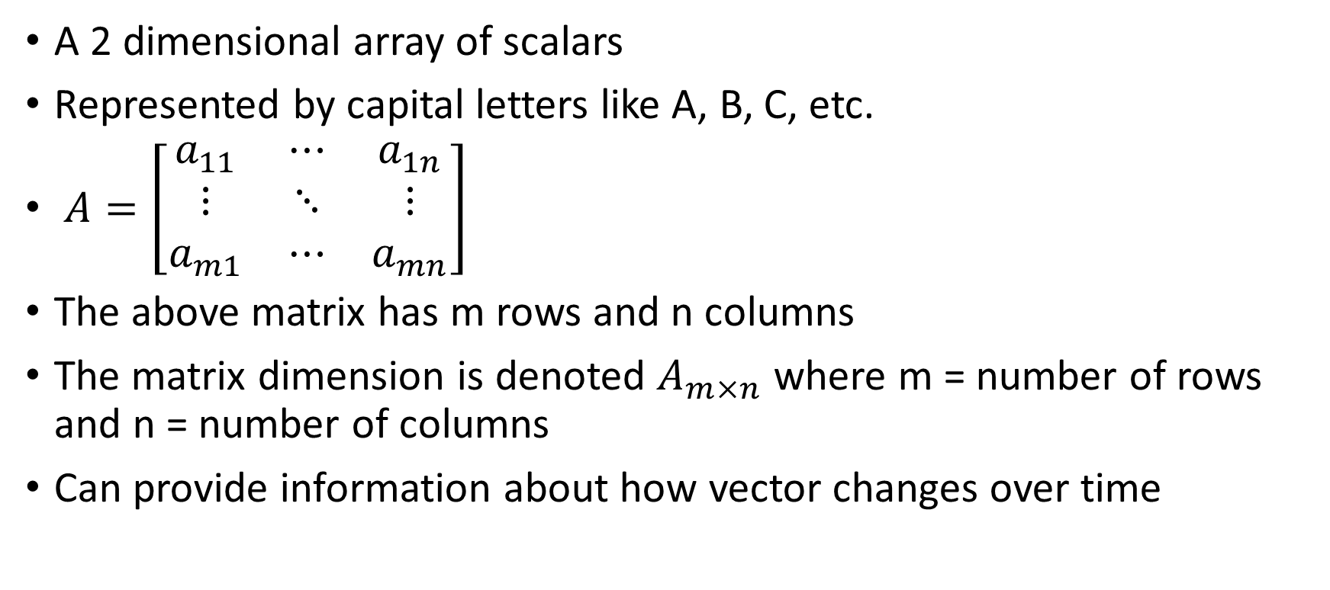
Matrices
A 2 dimensional array of scalars
Represented by capital letters like A, B, C, etc.
$A=\left[\begin{matrix}a_{11} & ⋯ & a_{1n} \\ ⋮ & ⋱ & ⋮ \\ a_{m1} & ⋯ & a_{mn}\end{matrix}\right]$
The above matrix has m rows and n columns
The matrix dimension is denoted $A_{m×n}$ where m = number of rows and n = number of columns
Can provide information about how vector changes over time

Slide 17
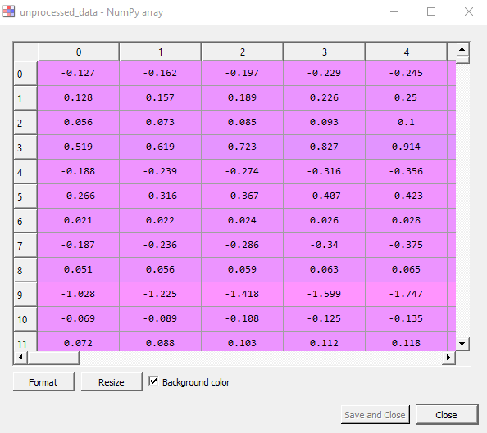

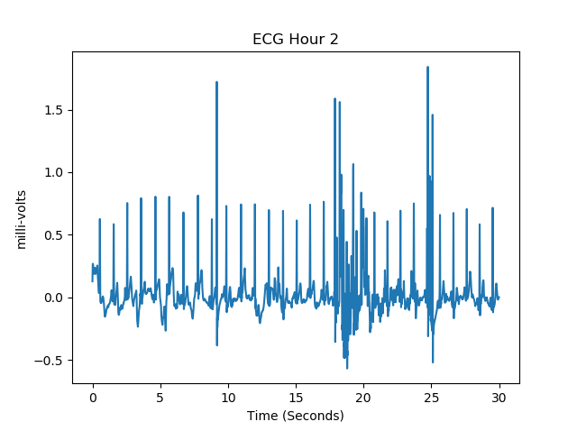
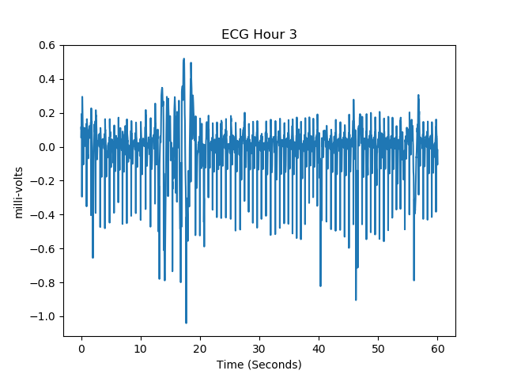
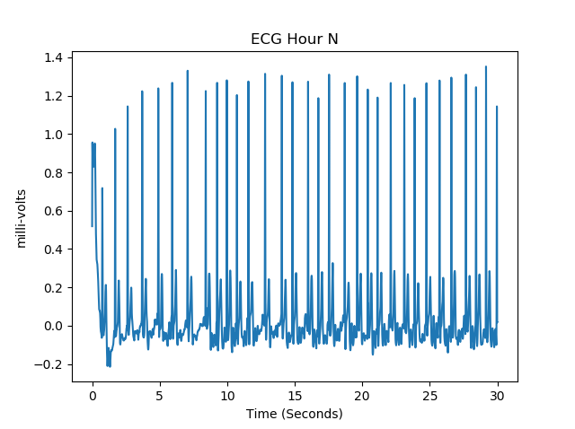
EKG Matrix: Each Col Is A Recording

Slide 18
Matrix Operations
Addition / subtraction
Scalar multiplication
Matrix dot product
Transpose

Slide 19
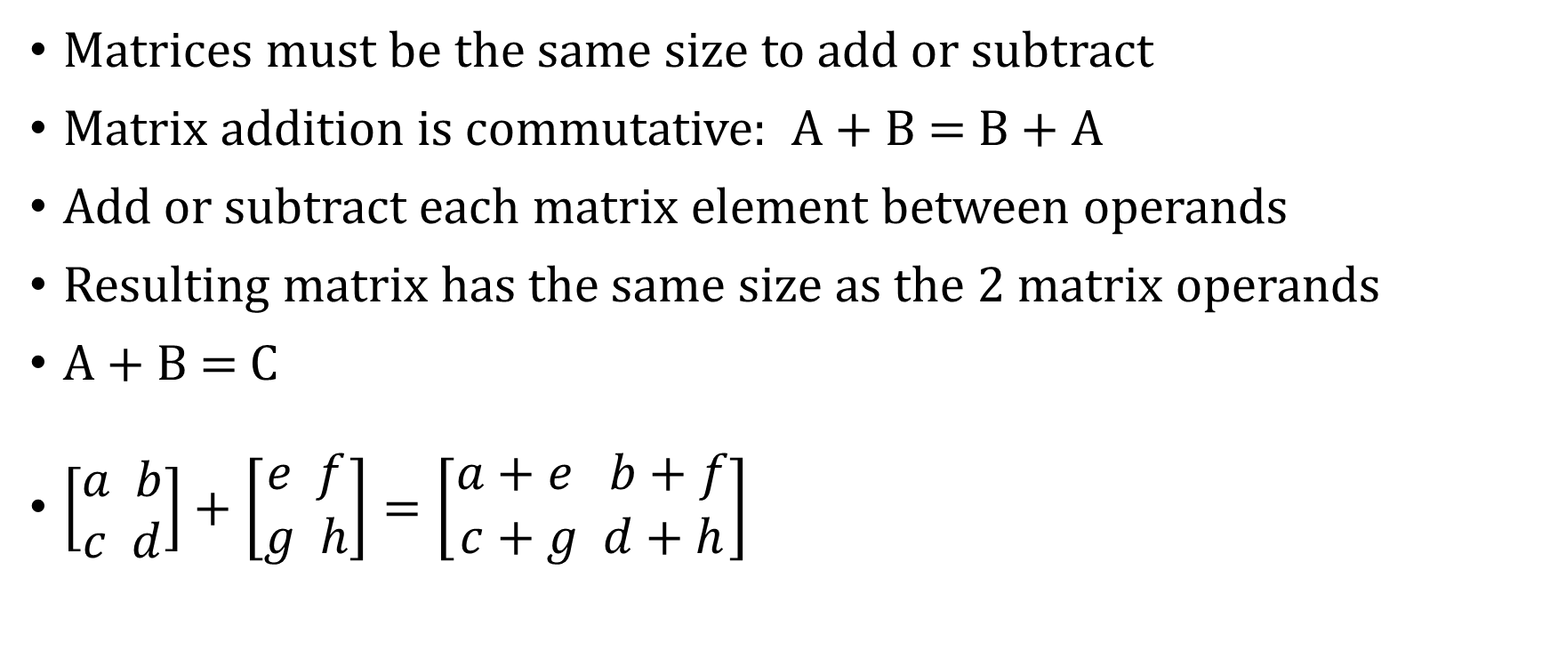
Matrix Addition / Subtraction
Matrices must be the same size to add or subtract
Matrix addition is commutative: A + B = B + A
Add or subtract each matrix element between operands
Resulting matrix has the same size as the 2 matrix operands
A + B = C
$\left[\begin{aligned}a b \\ c d\end{aligned}\right]+\left[\begin{aligned}e f \\ g h\end{aligned}\right]=\left[\begin{aligned}a+e b+f \\ c+g d+h\end{aligned}\right]$

Slide 20
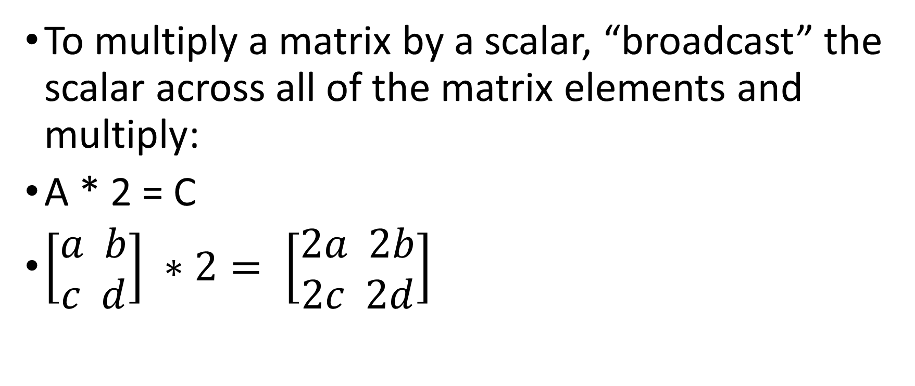
Matrix Multiplication by Scalar
To multiply a matrix by a scalar, “broadcast” the scalar across all of the matrix elements and multiply:
A * 2 = C
$\left[\begin{aligned}a b \\ c d\end{aligned}\right] ∗2= \left[\begin{aligned}2a 2b \\ 2c 2d\end{aligned}\right]$

Slide 21
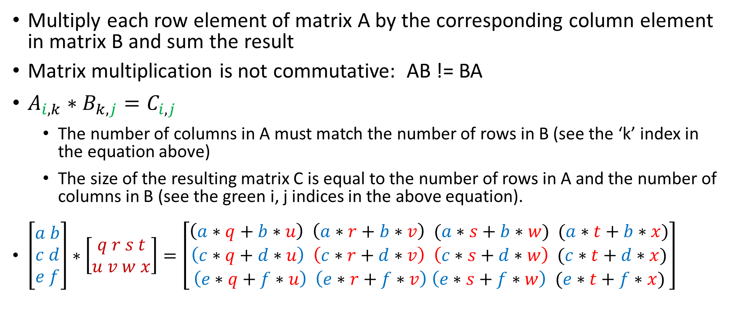
Matrix (Dot) Product
Multiply each row element of matrix A by the corresponding column element in matrix B and sum the result
Matrix multiplication is not commutative: AB != BA
$A_{i,k}∗B_{k,j}=C_{i,j}$
The number of columns in A must match the number of rows in B (see the ‘k’ index in the equation above)
The size of the resulting matrix C is equal to the number of rows in A and the number of columns in B (see the green i, j indices in the above equation).
$\left[\begin{aligned}a b \\ c d \\ e f\end{aligned}\right]∗\left[\begin{aligned}q r s t \\ u v w x\end{aligned}\right]=\left[\begin{aligned}\left(a∗q+b∗u\right) \left(a∗r+b∗v\right) (a∗s+b∗w) (a∗t+b∗x) \\ \left(c∗q+d∗u\right) \left(c∗r+d∗v\right) \left(c∗s+d∗w\right) (c∗t+d∗x) \\ \left(e∗q+f∗u\right) \left(e∗r+f∗v\right) \left(e∗s+f∗w\right) (e∗t+f∗x)\end{aligned}\right]$
Notes:
Good final queston

Slide 22
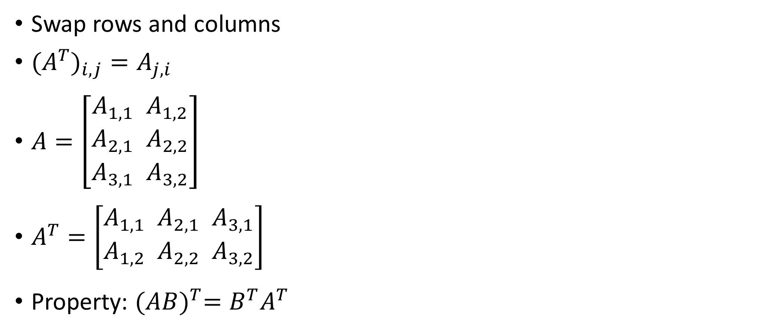
Matrix Transpose
Swap rows and columns
${{(A}^{T})}_{i,j}=A_{j,i}$
$A=\left[\begin{aligned}A_{1,1} { A}_{1,2} \\ A_{2,1}{ A}_{2,2} \\ A_{3,1}{ A}_{3,2}\end{aligned}\right]$
$A^{T}=\left[\begin{aligned}A_{1,1}{ A}_{2,1}{ A}_{3,1} \\ A_{1,2}{ A}_{2,2}{ A}_{3,2}\end{aligned}\right]$
Property: ${(AB)}^{T}=B^{T}A^{T}$

Slide 23
Tensors
A tensor is an array of numbers, that may have
zero dimensions, and be a scalar
one dimension, and be a vector
two dimensions, and be a matrix
or more dimensions.

Slide 24
Difference Between Tensor and Matrix
A matrix is a 2-dimensional grid of numbers
A tensor is a generalized matrix
A tensor includes all of the following
0 dimension (AKA scalar)
1 dimension (AKA vector)
2 dimension (AKA matrix)
Or higher dimension
A tensor is more general and flexible than a matrix
The dimension of the tensor is known as it’s “rank”. Example, a 3 dimensional numpy array (array[][][]) is a tensor of rank 3.
Notes:
https://medium.com/@quantumsteinke/whats-the-difference-between-a-matrix-and-a-tensor-4505fbdc576c

Slide 25
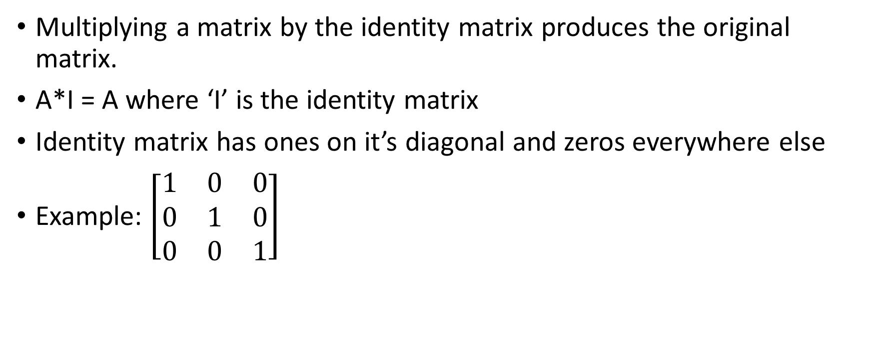
Identity Matrix
Multiplying a matrix by the identity matrix produces the original matrix.
A*I = A where ‘I’ is the identity matrix
Identity matrix has ones on it’s diagonal and zeros everywhere else
Example: $\left[\begin{matrix}1 & 0 & 0 \\ 0 & 1 & 0 \\ 0 & 0 & 1\end{matrix}\right]$

Slide 26
Linear Combinations
A linear combination is an expression constructed from a set of terms by multiplying each term by a constant and adding the results.
Example: The linear combination of the terms x and y would be constructed by multiplying each of the terms by a constant and adding.
ax + by where a and b are constants

Slide 27
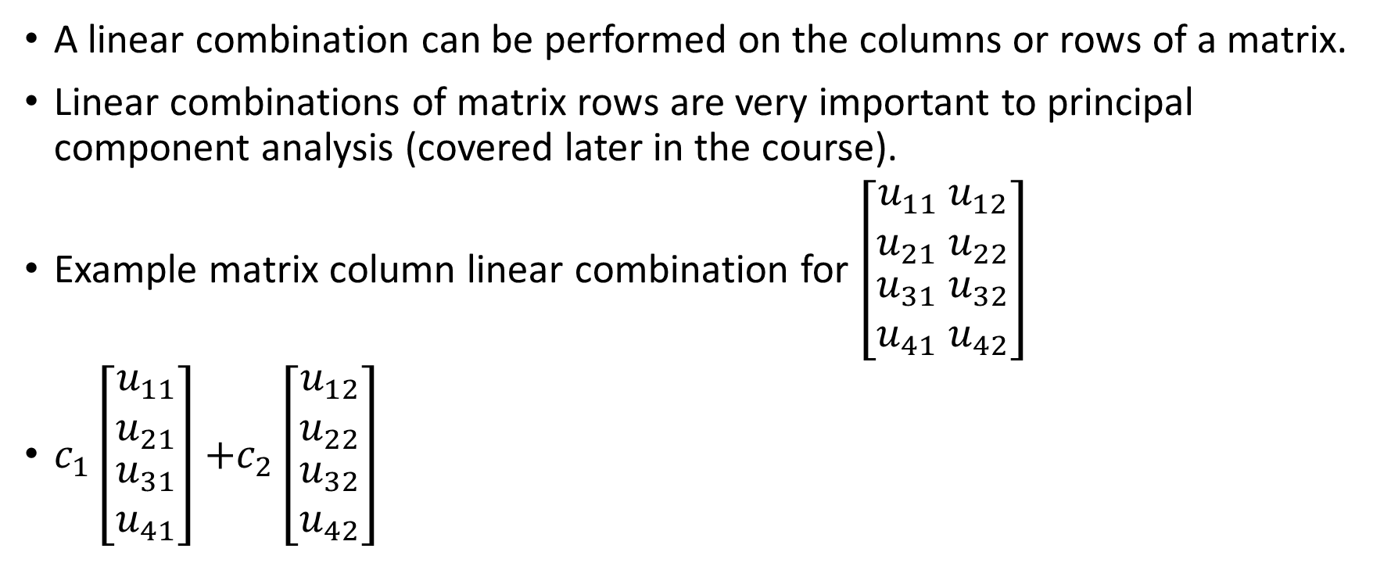
Linear Combinations
A linear combination can be performed on the columns or rows of a matrix.
Linear combinations of matrix rows are very important to principal component analysis (covered later in the course).
Example matrix column linear combination for $\left[\begin{matrix}u_{11} u_{12} \\ u_{21}{ u}_{22} \\ \begin{aligned}u_{31}{ u}_{32} \\ u_{41}{ u}_{42}\end{aligned}\end{matrix}\right]$
$c_{1}\left[\begin{matrix}u_{11} \\ u_{21} \\ \begin{aligned}u_{31} \\ u_{41}\end{aligned}\end{matrix}\right]$ $+c_{2}\left[\begin{matrix}u_{12} \\ u_{22} \\ \begin{aligned}u_{32} \\ u_{42}\end{aligned}\end{matrix}\right]$
Notes:
Good final question

